Slide 1
Closet
Fashion Demo
Gagan Saini
MCA 4th Semester
Industrial Project
A E-Commerce website solution for fashion.
Revolutionizing Fashion Through Smart Wardrobe Management, Easy access to every corner.

Slide 2
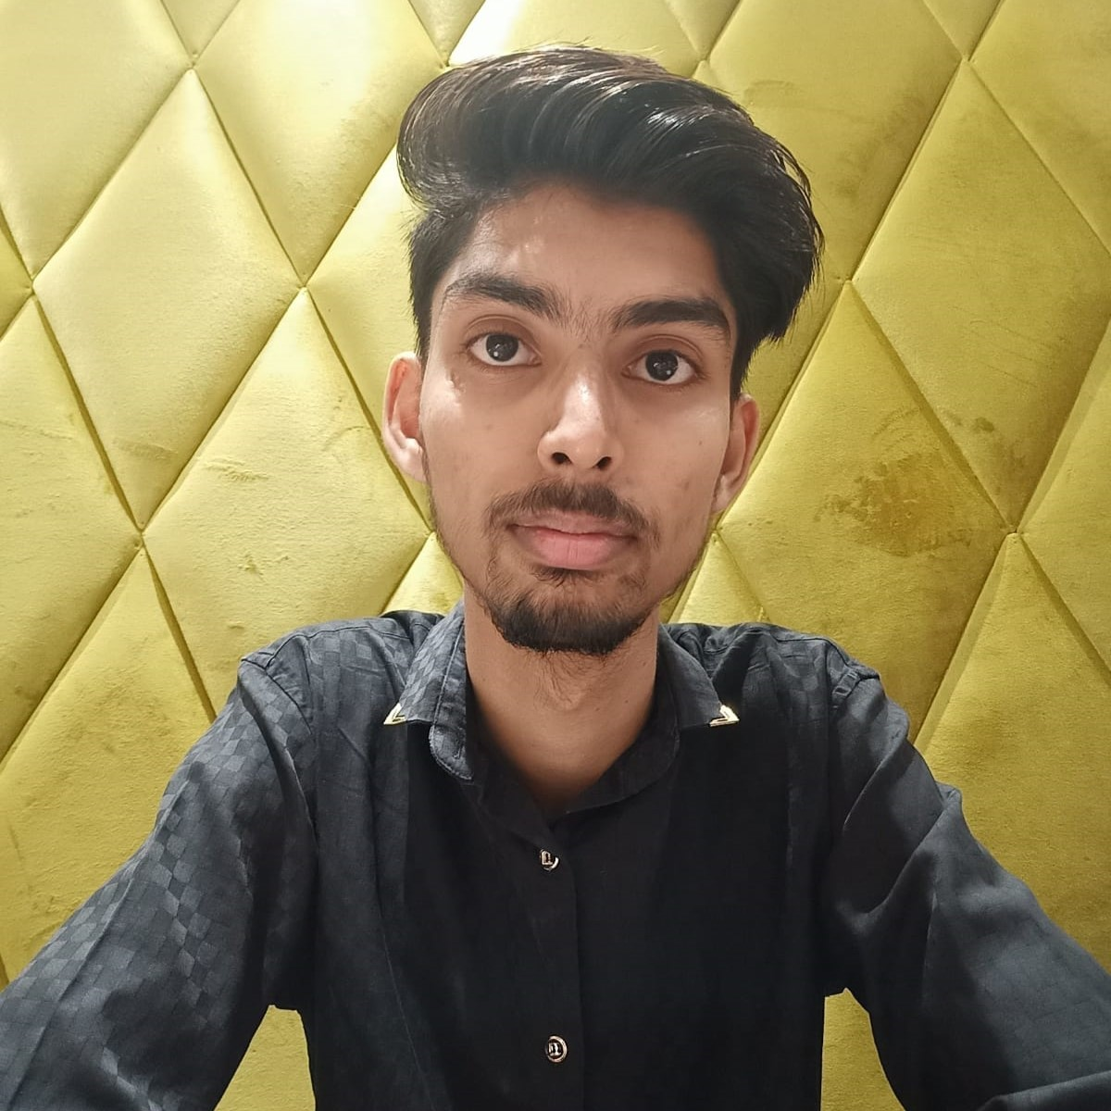
Product team
Gagan Saini
Industrial Project
Gagan Saini
Software Engineer
A passionate and skilled Software Developer Engineer with expertise in React.js and a proven track record of creating impactful web applications.
With over 5M+ views, my work has captured the attention of a wide audience, showcasing my dedication to delivering high-quality solutions.

Slide 3
Welcome
To all the respected teachers and Students.
To Closet Fashion Demo

Slide 4
A short history of the product
Gagan Saini
Industrial Product
December
January
February
March
April
Today
Product Debut
Finalize the product idea, and created the outline for it. Designed the flow and schema for system.
Product Setup
Created the Home page, and product details page with all the details and navigation.
Cart Feature
Users are allowed to save products into their cart and continue shopping where they left without disturbance.
Become Seller
Now users can become seller also and sell their product, they just need to activate seller account..
Admin Panel
Created the seller admin panel, for managing the products, orders from the seller side..
Ready to Prod
Closet Fashion is ready with MVP features and currently going through beta testing phase.

Slide 5
Agenda
Gagan Saini
Industrial Project
1. Product Preview
2. Features Included
3. Target Audience

Slide 6
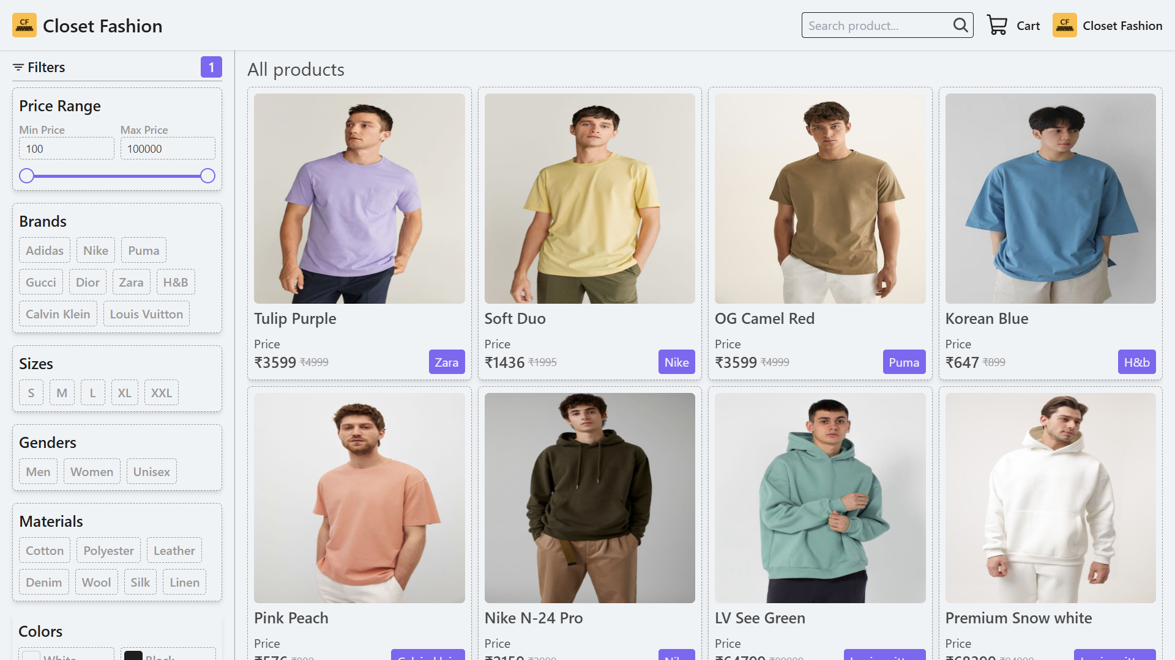

Gagan Saini
Industrial Project
Closet Fashion transforms the way people style, organize, and shop for clothes using AI-powered recommendations and virtual try-ons.
It delivers a smarter, more personalized fashion experience—helping users look confident, save time, and discover outfits tailored perfectly to their style

Slide 7

Key capabilities
Gagan Saini
Industrial Project
1
2
3
4
5
Home Page
Product Page
Cart Page
Upload Product
Admin Panel
Explores the products, filter them based brand, price, size, color, materials.
Product page shows details pf a product, including name, description, brand, sizes available, action buttons.
It shows the list of products you added in your cart, along with total cart summary.
Become seller and upload your own custom product for selling them on this platform.
Seller has to maintain stock, track order status, this is where they can do all of admin tasks.

Slide 8
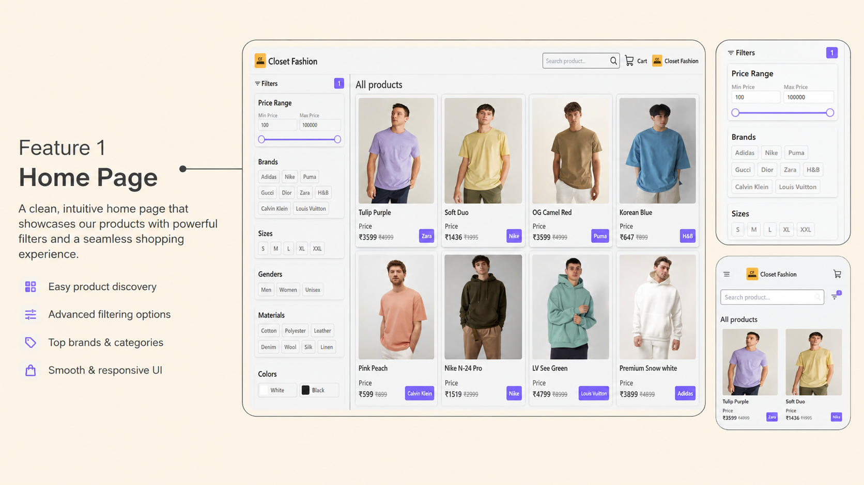


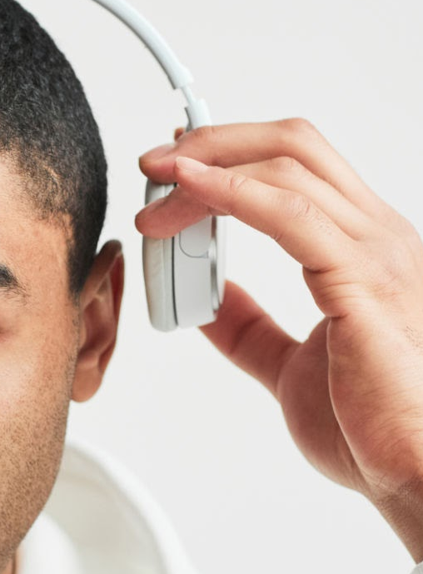
Feature 1
Highlight a key product feature. If you already mentioned this feature in previous slides, use this space to describe it in more depth. Explain how it benefits users and solves their pain points. Make sure the image and metrics help support your description.
Gagan Saini
Industrial Project

Slide 9
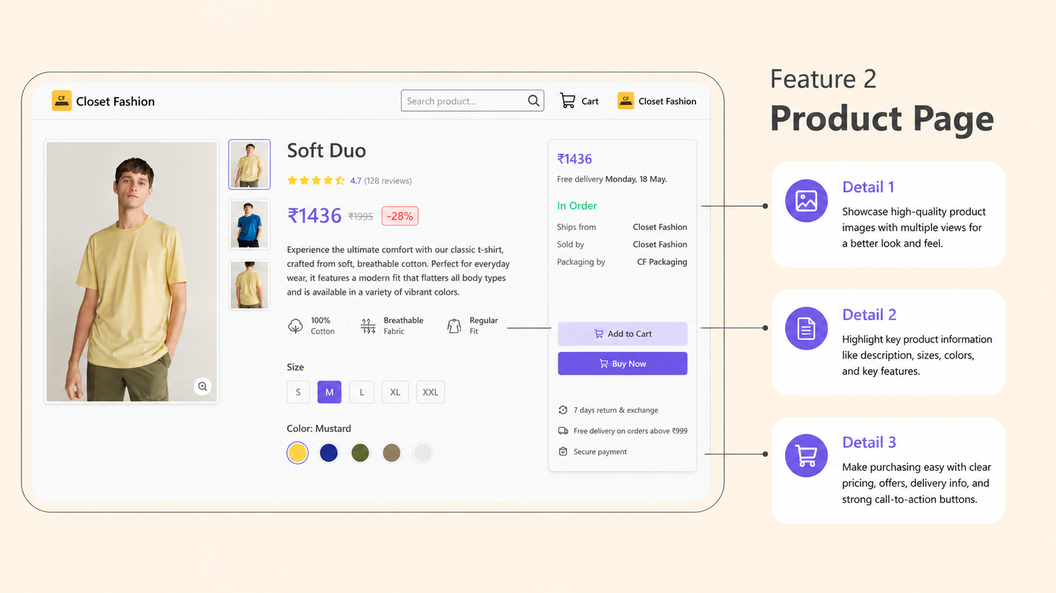
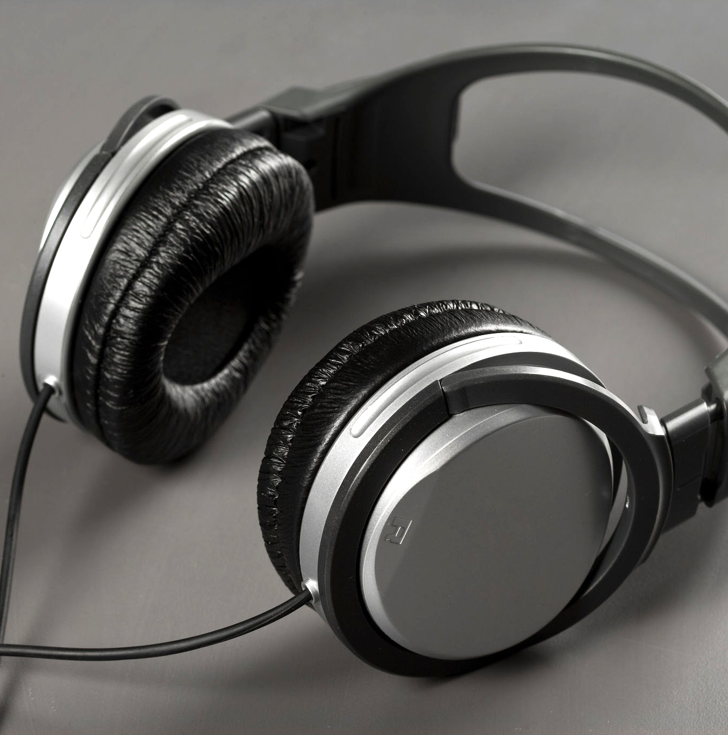
Feature 2
Industrial Project
Detail 1
Point to an aspect of this feature in the photo, then describe it here.
Detail 2
Point to an aspect of this feature in the photo, then describe it here.
Detail 3
Point to an aspect of this feature in the photo, then describe it here.

Slide 10
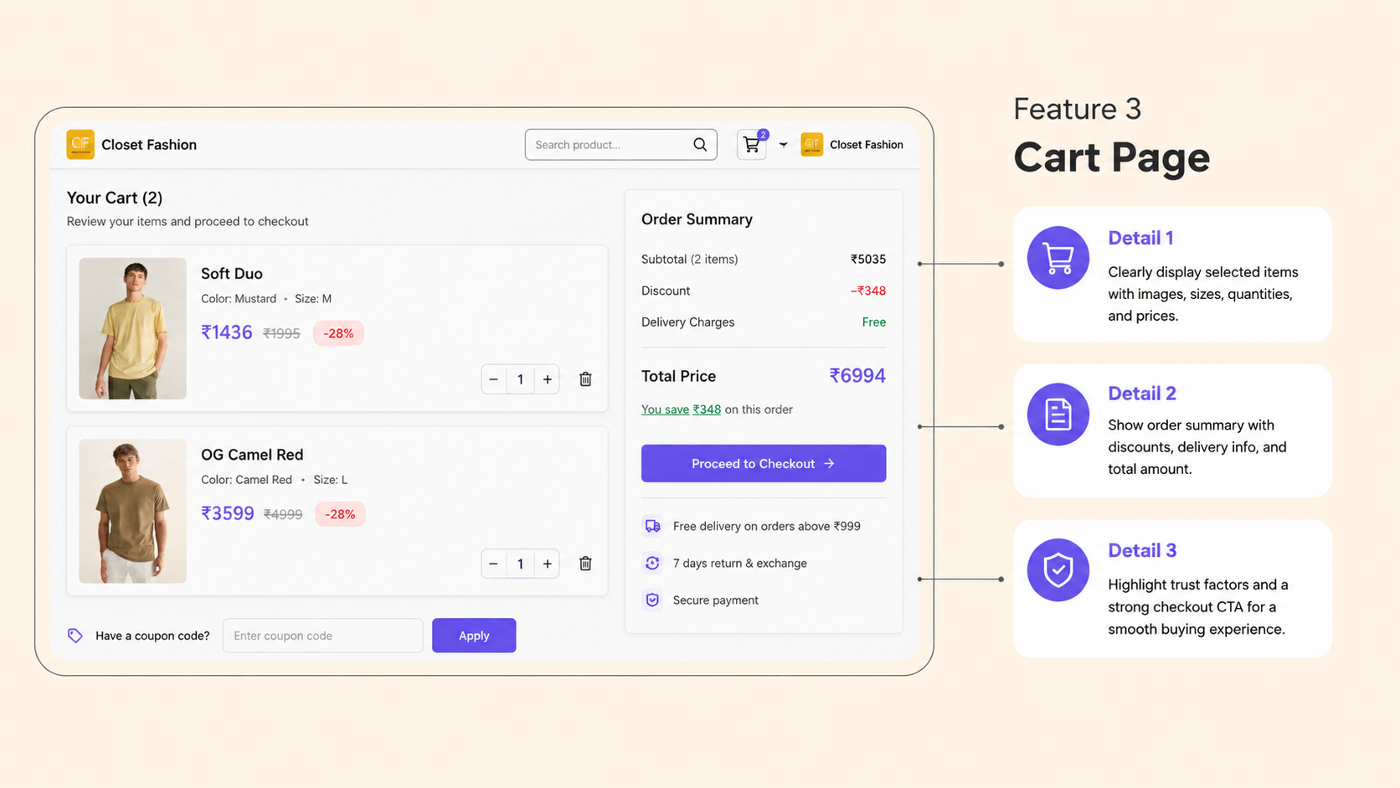

Feature 3
Highlight a key product feature. If you already mentioned this feature in previous slides, use this space to describe it in more depth. Explain how it benefits users and solves their pain points. Make sure the image and metrics help support your description.

Slide 11
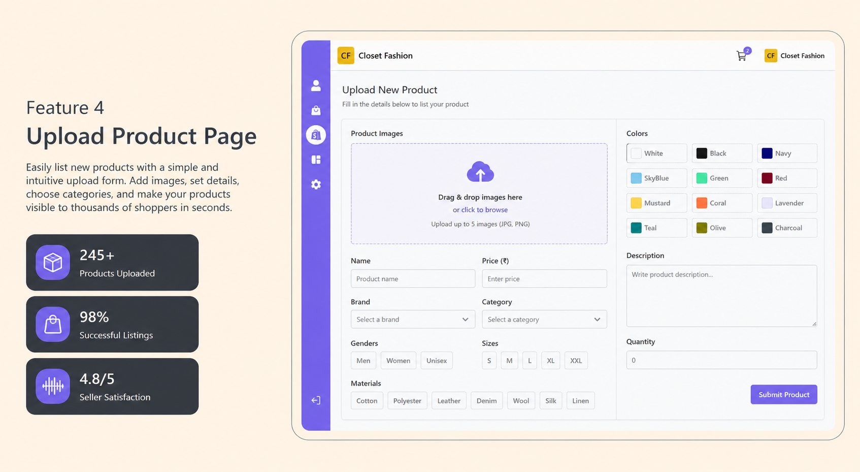


Feature 4
Highlight a key product feature. If you already mentioned this feature in previous slides, use this space to describe it in more depth. Explain how it benefits users and solves their pain points. Make sure the image and metrics help support your description.
00
Metric description
00
Metric description
00
Metric description

Slide 12
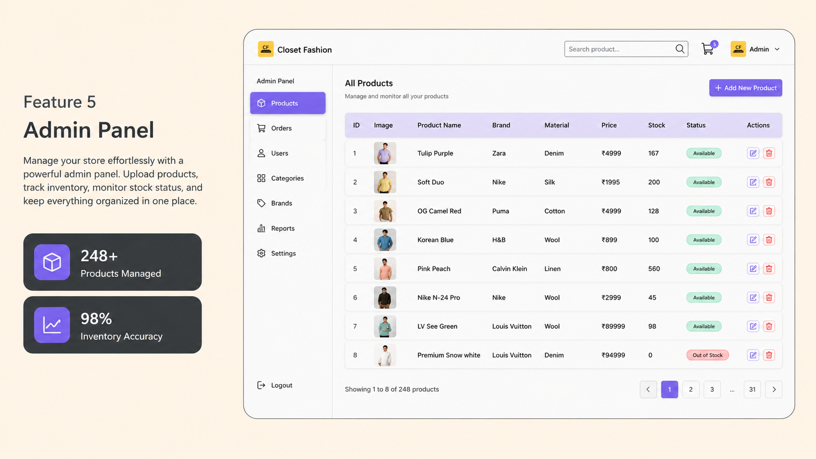
Feature 5
Highlight a key product feature. If you already mentioned this feature in previous slides, use this space to describe it in more depth. Explain how it benefits users and solves their pain points. Make sure the accompanying metrics help support your description.
00
Metric description
00
00
Metric description
Metric description

Slide 13





Target
audiences
Company Name
Eliza, 26y
Robert, 34
Bikaner
MBA
Jaipur
Engineering
Love Fashion
Sales Head
Trendy tryouts!
Tech Lead
Analyzed a user behavior. For example, they love exploring trendy fashion on the Closet Fashion
Analyzed a user behavior. For example, they love exploring trendy fashion on the Closet Fashion.
They continue to product page, check different sizes, colors, and details and receive a superfast delivery.
They continue to product page, check different sizes, colors, and details and receive a superfast delivery.
“Fashion fades, only style remains the same”
“Style is a way to say who you are without speaking”

Slide 14
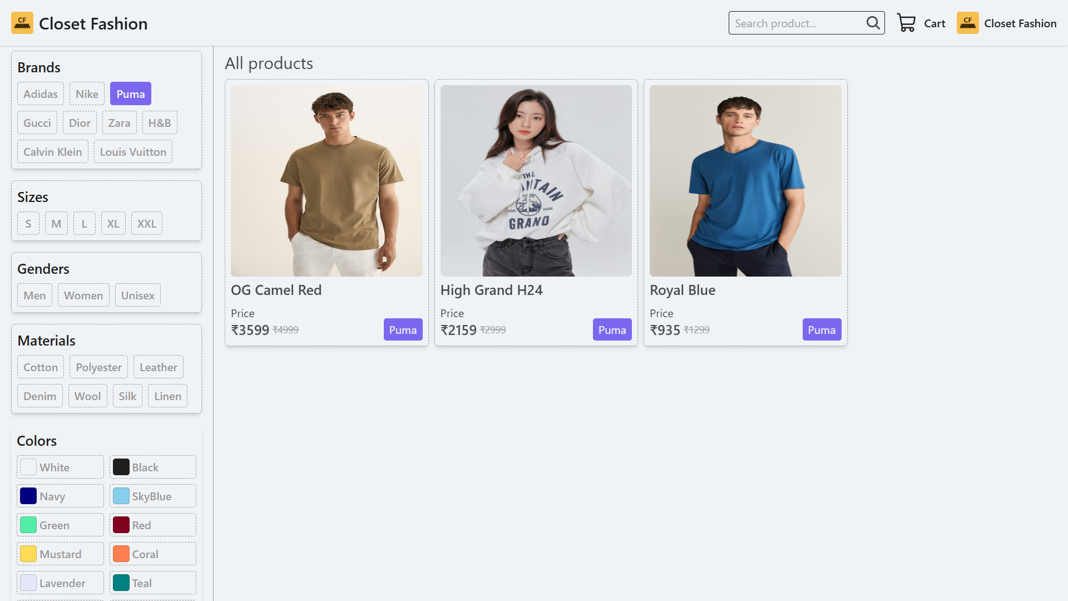
A final look at Closet Fashion
A modern fashion platform designed for online shopping.
Combines elegant UI with smooth and user-friendly interactions.
1
Simplifies product management for both customers and admins.
2
Coming Soon
Built to deliver a scalable and future-ready ecommerce experience.
3
4

Slide 15
Key takeaways
Company Name
Date
1
2
3
4
Smart Shopping
Better UI/UX
Future Ready
Efficient Management
Easy product discovery with a clean and modern shopping experience.
Smooth navigation, detailed product pages, and simple checkout flow.
Powerful admin tools for product uploads and inventory control.
Built for scalable fashion e-commerce and future AI integration.

Slide 16

Ask me anything!

Slide 17

Resources
Questions?
Please reach out to
gagansaini10999@gmail.com
Thank you!

